Slide 1
Building safe(r) spaces within Queer and Trans, Black Indigenous, People of Color and Roma communities
Fayaaz Joemmanbaks (they/them) & Olave Nduwanje (she/her)

Slide 2
No conflict of interest

Slide 3
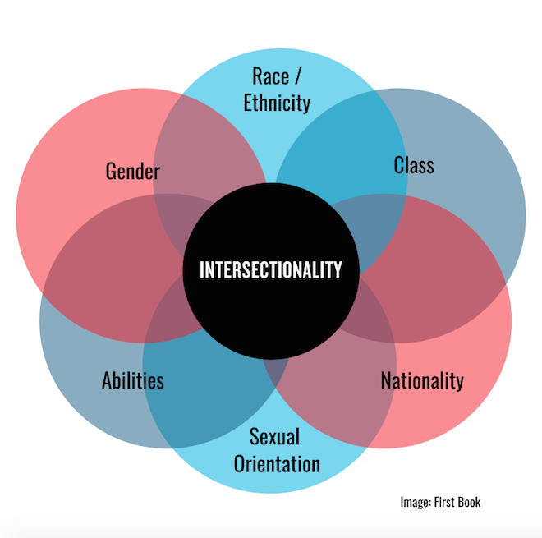
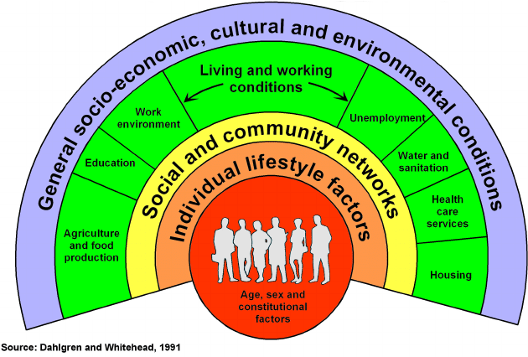
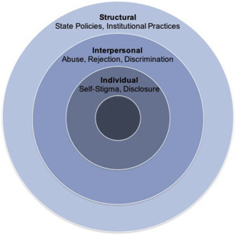
Theoretical models
Health determinants
(Dahlgren & Whitehead)
Intersectionality
(Kimberlé Crenshaw)
Minority Stress Model (Meyer)
*QPOC = Queer (or LGBTQIA+) People of Color

Slide 4
What do we know from research?
First national study among bi+ adults in the Netherlands
Survey among 3000 bi+ 16-55 year olds
Qualitative study
Bi+ Netherlands commissioned the study to the Bi+ Research Consortium
Financially supported by the Dutch ministry / Equality Department
Authors
Dr. Marianne Cense¹ , Fayaaz Joemmanbaks¹, M.Sc., Dr. Diana van Bergen², Dr. Laura Baams², Dr. Hanneke de Graaf¹, Dr. Emiel Maliepaard, Prof. Dr. Henny Bos³, Prof. Dr. John de Wit⁴, Prof. Dr. Kai Jonas⁵, Dr. Chantal den Daas⁶
Affiliations
1 Rutgers 2 University of Groningen 3 University of Amsterdam 4 Utrecht University 5 Maastricht University
6 University of Abderdeen
6 University of Aberdeen

Slide 5
Results
i) Starts at early stage: upbringing of family, norms and values (heteronormative, binary) > no exposure to bi+
ii) Sexual development:
-Attraction to multiple genders
-No labelling or not wanting to identify with bi+
iii) Exclusion within LGBTQIA+ communities (mononormative and binary)
“If I go hard enough on my knees and pray hard enough, then maybe it (ed. sexual orientation) will go away”
“So what I said, in gay and lesbian world a lot of: yes but, you haven’t chosen yet”

Slide 6
Main findings
Bisexual people most often survivors
Gay men often experience online sexual intimidation
No significant differences in race/ethnicity and educational level
Sexual victimization amongst youth living at home and in low-income households
Perpetrator is most often an acquaintance

Slide 7
Results

Slide 8
Navigating strategies
i) Agency: direction and control of your body and story
ii) Break with people who do not accept you
iii) Carefully navigate: subtle strategies without direct confrontation
iv) Activism: political or social change
“You do not have to stay friends with everyone and that is what I always thought. But it does not have to. Well, that is the revelation of the century to me”

Slide 9
Discussion and limitations
Defining gender
Emphasis on perpetrator
Lack of data on youth <16 years
Power and dependency
Explanations for bi and trans people of color

Slide 10
Recommendations
Structural norms where bi+ people do not fit in, but some people are able to navigate within (or around) those. A lot needs to be done…
Fight discrimination and exclusion on an institutional level
Representation of bi+ people in media, school, work (role models, stories, inclusive education)
Community building and bi+ inclusive spaces
Follow-up research: people of color, youth, trans- and non-binary

Slide 11
What now?

Slide 12
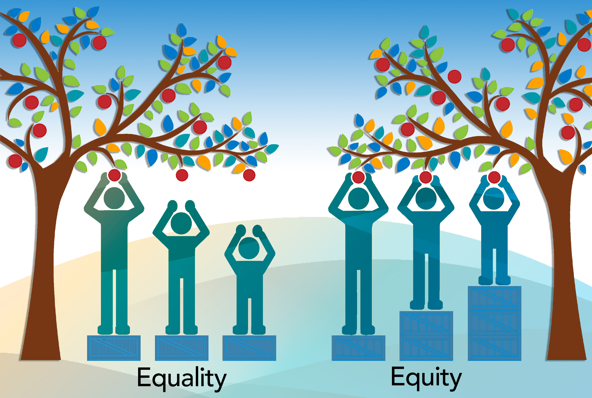
What works - I
Equity (not equality)
Call-in (no call-out)
Accessibility
Representation (not tokenizing)
No buzz words!

Slide 13
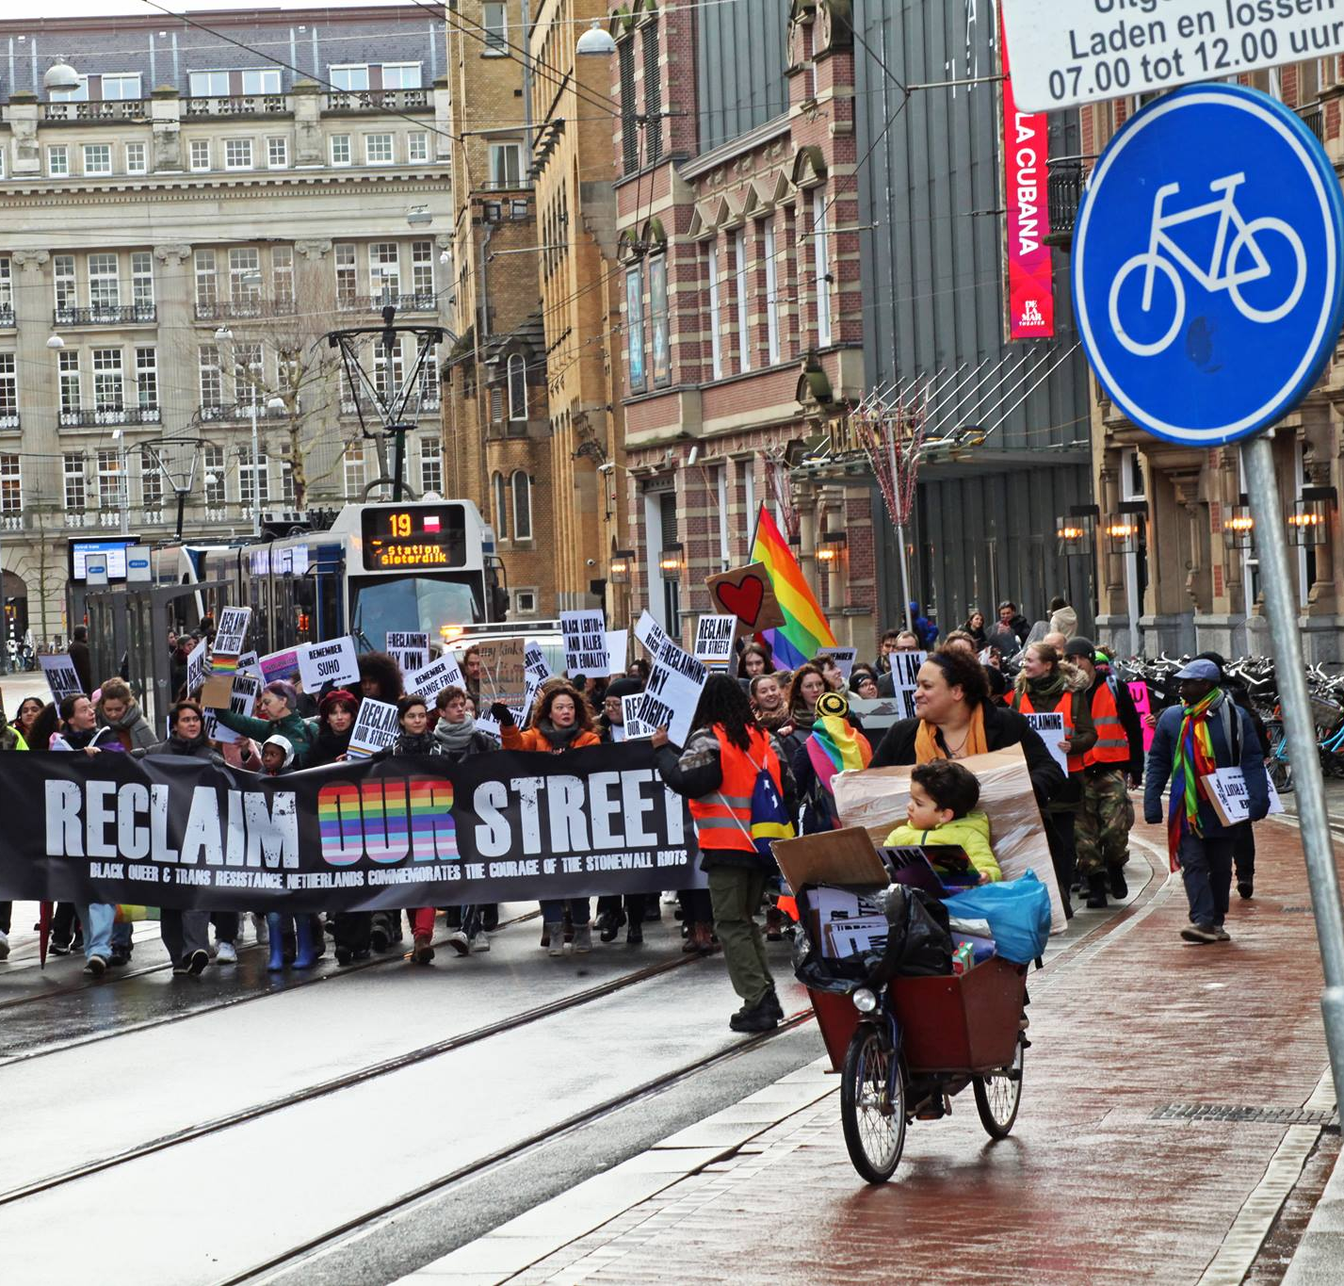
What works - II
Safe(r) spaces (e.g. Colored Qollective, Trans United)
Inclusive language
Role-models
Representation

Slide 14
Inclusive language
Migration background <> people of color
“Blank” <> white
Crazy/stupid <> neurodivers
Prostitute <> sex worker
HIV positive <> people who live with hiv
Intersex condition <> intersex people

Slide 15
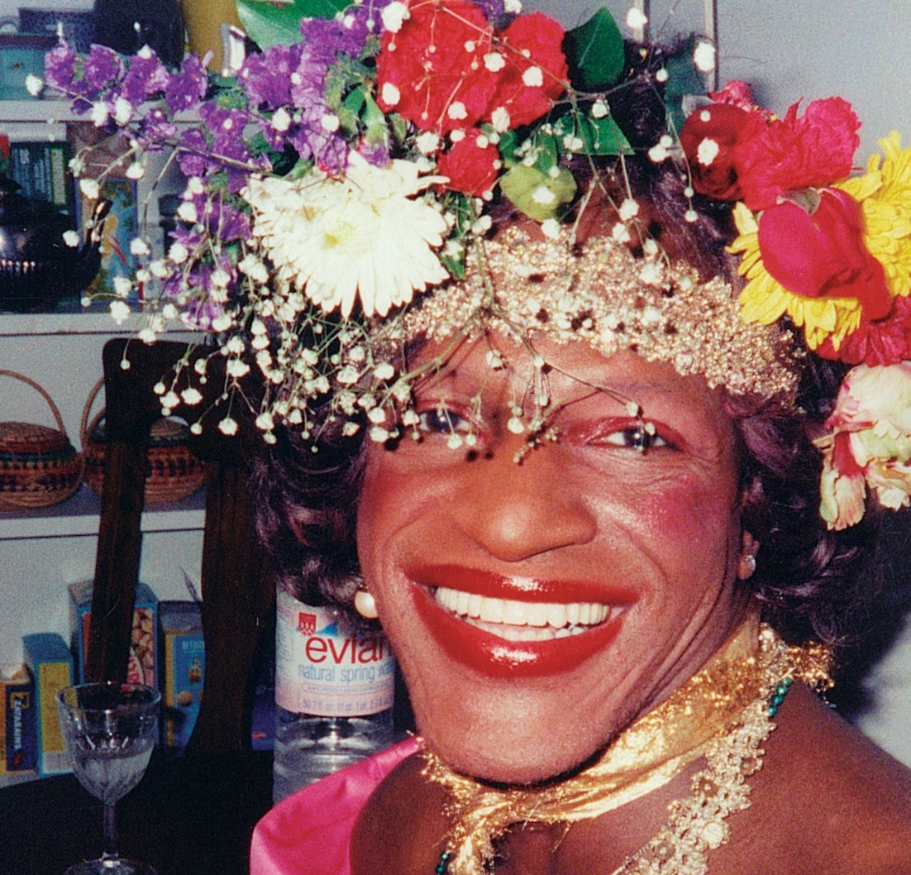
Trans and non-binary people of color
Frontliners
Community impact
Trans joy, vogueing, coming-in

Slide 16
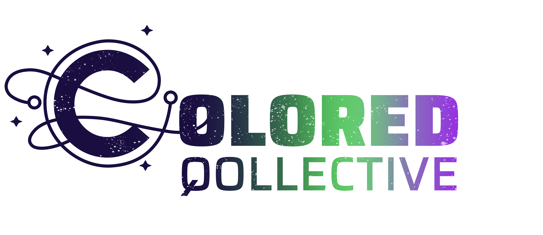
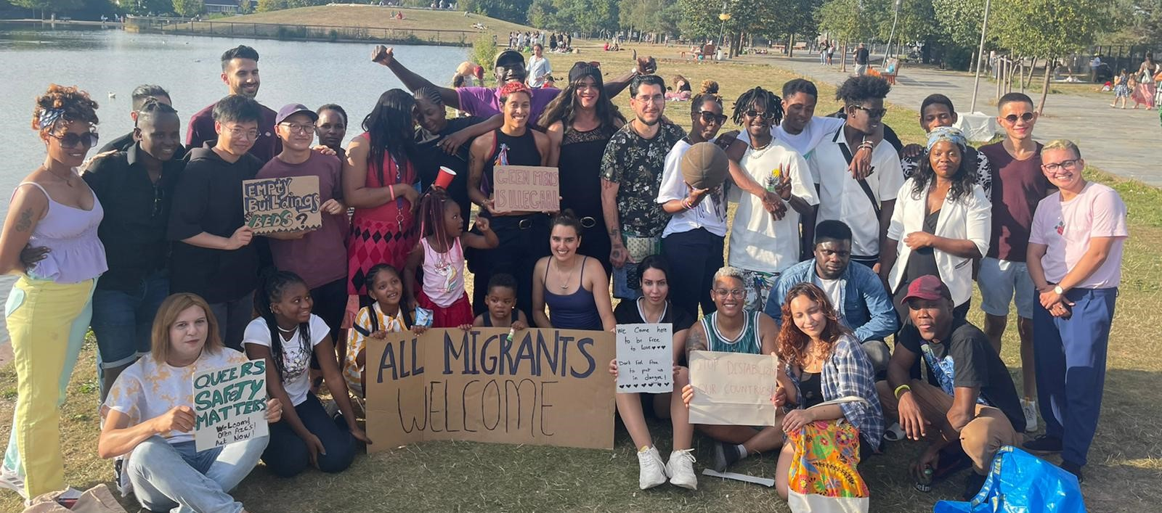
Importance of safer spaces
Intersectional approach
For us, by us
Grass-roots interventions
Sense of belonging

Slide 17
Thank you and have a good conference!

